Slide 1
Let’s Talk Trails! Ohio Trail Connections Webinar Series
Brian Housh
Midwest Policy Manager
Ohio Trails Partnership Vice President
Yellow Springs Council President
Trails are at the heart of healthy, thriving communities!
Notes:
There are exciting initiatives at the state level on the topic of trails. 2018 is a pivotal year. It’s critical that elected officials and community leaders do their part to send strong messages to the state house for creating a new and expanded platform for trail and bikeway funding for both construction and for badly needed maintenance.

Slide 2
The Ohio Trails Vision
Several themes emerged from the public outreach effort –
Partnerships and volunteer groups have been key to establishing and managing Ohio’s trails.
While communities are developing plans for trails across the state, the availability of dedicated funding to maintain the existing trails and build new trails has not yet caught up with the demand.
Better marketing of Ohio’s existing trail opportunities is an excellent way to enhance their impact.
It is critical to ensure that Ohio’s trails connect people and communities as well as provide needed amenities.
Through a collaborative effort, with state and local government, trail managers, trail advocates and trail users working together, Ohioans can create a world-class trail system.
Notes:
Key players within the Rails-to-Trails and Buckeye Trail Association are assembling and convening sessions with representatives of agencies, non-profit advocacy groups and even business groups from across the state who are already involved in driving trail, active transportation, recreation and public health initiatives in their respective regions. Currently (early 2018) the Network is meeting every 6-8 weeks to develop in greater detail the elements of a successful statewide program. This OhioNetwork will lead on assessing options and then developing recommendations to the General Assembly in the areas of:
1. High level criteria for the facilities which ultimately constitute the statewide network of trails & bikeways
2. Policies
3. Funding mechanisms
4. Funding amounts

Slide 3
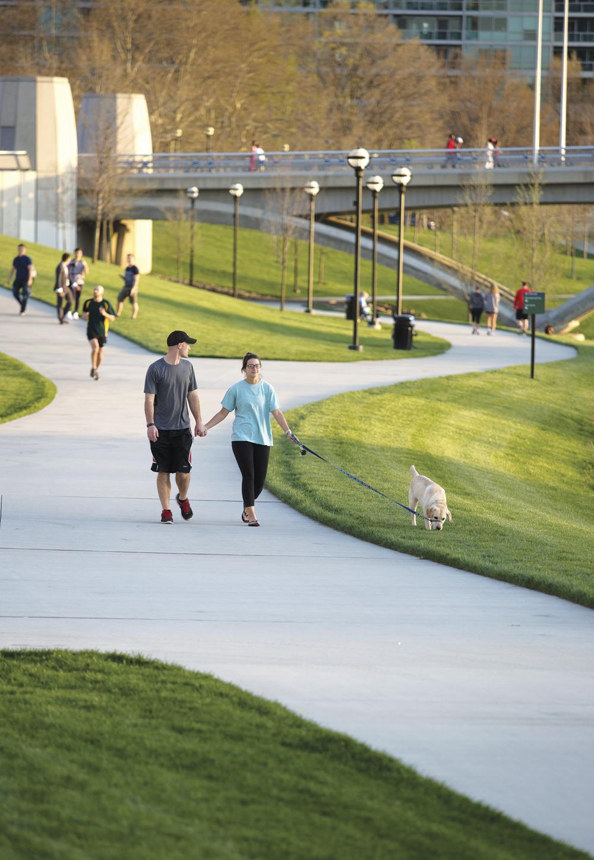
2021 Talking Pts – “Ohioans Want Trails”
The dramatic increase – ranging from 70-200% in most places - in trail use during the COVID-19 crisis highlights the importance of this critical infrastructure for all Ohioans. This is an important time to continue funding trail maintenance and development given the capacity challenges on our state's trails systems.
Visit COVID-19 Resources @ www.railstotrails.org/COVID19
Notes:
Key players within the Rails-to-Trails and Buckeye Trail Association are assembling and convening sessions with representatives of agencies, non-profit advocacy groups and even business groups from across the state who are already involved in driving trail, active transportation, recreation and public health initiatives in their respective regions. Currently (early 2018) the Network is meeting every 6-8 weeks to develop in greater detail the elements of a successful statewide program. This OhioNetwork will lead on assessing options and then developing recommendations to the General Assembly in the areas of:
1. High level criteria for the facilities which ultimately constitute the statewide network of trails & bikeways
2. Policies
3. Funding mechanisms
4. Funding amounts

Slide 4
2021 Talking Pts – “Mental Well-Being Key”
Our public health officials are emphasizing the need to prioritize mental health and well-being in response to this pandemic, and parks and trails are ideal, providing safe and relaxing spaces that "often" allow for physical distancing. Currently, many municipalities are opening streets to accommodate pedestrians and cyclists, underscoring the need for supporting trails networks.
Notes:
Key players within the Rails-to-Trails and Buckeye Trail Association are assembling and convening sessions with representatives of agencies, non-profit advocacy groups and even business groups from across the state who are already involved in driving trail, active transportation, recreation and public health initiatives in their respective regions. Currently (early 2018) the Network is meeting every 6-8 weeks to develop in greater detail the elements of a successful statewide program. This OhioNetwork will lead on assessing options and then developing recommendations to the General Assembly in the areas of:
1. High level criteria for the facilities which ultimately constitute the statewide network of trails & bikeways
2. Policies
3. Funding mechanisms
4. Funding amounts

Slide 5
2021 Talking Pts – “Support Physical Health”
Physical health is equally important in response to the Coronavirus. Trails are great spaces for exercise - walking, biking, rolling - and provide a safe environment by "often" allowing for distancing and should be accessible to all Ohioans. The current crisis has exposed many gaps, including the lack of safe places to walk and bike for a good number of your constituents.
Notes:
Key players within the Rails-to-Trails and Buckeye Trail Association are assembling and convening sessions with representatives of agencies, non-profit advocacy groups and even business groups from across the state who are already involved in driving trail, active transportation, recreation and public health initiatives in their respective regions. Currently (early 2018) the Network is meeting every 6-8 weeks to develop in greater detail the elements of a successful statewide program. This OhioNetwork will lead on assessing options and then developing recommendations to the General Assembly in the areas of:
1. High level criteria for the facilities which ultimately constitute the statewide network of trails & bikeways
2. Policies
3. Funding mechanisms
4. Funding amounts

Slide 6
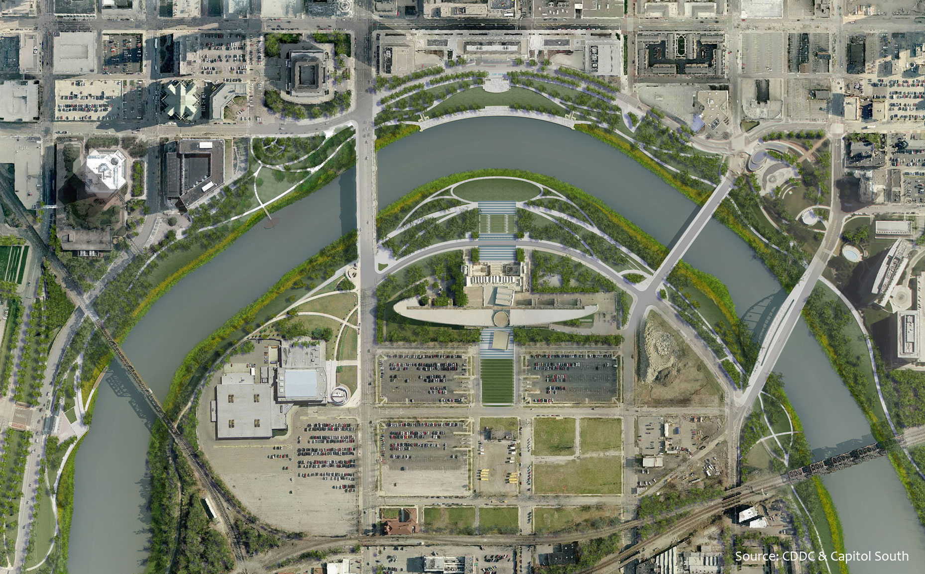
2021 Talking Pts – “Trails = Economic Recovery”
State investments in trails provide significant 'bang for the buck’. According to the FHWA, trail projects bring more jobs per dollar invested than does road construction and stimulate the economy in many ways. Trails secure lasting economic benefits for our communities as local businesses develop along the trails and our state attracts more visitors.
Notes:
Key players within the Rails-to-Trails and Buckeye Trail Association are assembling and convening sessions with representatives of agencies, non-profit advocacy groups and even business groups from across the state who are already involved in driving trail, active transportation, recreation and public health initiatives in their respective regions. Currently (early 2018) the Network is meeting every 6-8 weeks to develop in greater detail the elements of a successful statewide program. This OhioNetwork will lead on assessing options and then developing recommendations to the General Assembly in the areas of:
1. High level criteria for the facilities which ultimately constitute the statewide network of trails & bikeways
2. Policies
3. Funding mechanisms
4. Funding amounts

Slide 7
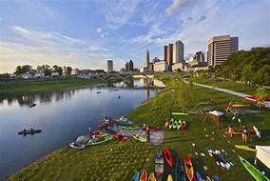
2021 Talking Pts – “Critical Part of Response”
Trails mean business! Maintaining and expanding trails networks generate significant economic activity. Currently, bike shops are not able to keep up with the demand, and we are seeing similar trends for other outdoor recreation-related businesses. Trails generate billions for the Buckeye State, supporting a variety of businesses - ice cream shops, B&Bs, breweries.
Notes:
Key players within the Rails-to-Trails and Buckeye Trail Association are assembling and convening sessions with representatives of agencies, non-profit advocacy groups and even business groups from across the state who are already involved in driving trail, active transportation, recreation and public health initiatives in their respective regions. Currently (early 2018) the Network is meeting every 6-8 weeks to develop in greater detail the elements of a successful statewide program. This OhioNetwork will lead on assessing options and then developing recommendations to the General Assembly in the areas of:
1. High level criteria for the facilities which ultimately constitute the statewide network of trails & bikeways
2. Policies
3. Funding mechanisms
4. Funding amounts

Slide 8
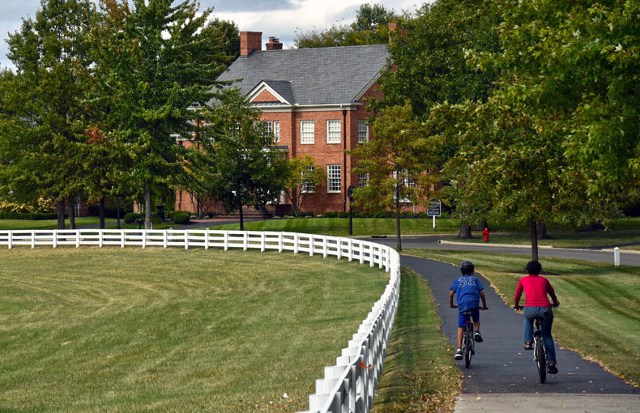
2021 Talking Pts – “Trails Promote Equity”
These challenging times require thoughtful allocation of state resources to address the health and economic impacts of COVID-19. The current crisis has exposed many inequities in our state, and all Ohioans need and deserve access to safe and well-maintained trails. It is clear that there has been no better time in the 20-year history of the Clean Ohio Fund to continue trails funding so that more Ohioans can take part in these tremendous quality of life amenities.
Notes:
Key players within the Rails-to-Trails and Buckeye Trail Association are assembling and convening sessions with representatives of agencies, non-profit advocacy groups and even business groups from across the state who are already involved in driving trail, active transportation, recreation and public health initiatives in their respective regions. Currently (early 2018) the Network is meeting every 6-8 weeks to develop in greater detail the elements of a successful statewide program. This OhioNetwork will lead on assessing options and then developing recommendations to the General Assembly in the areas of:
1. High level criteria for the facilities which ultimately constitute the statewide network of trails & bikeways
2. Policies
3. Funding mechanisms
4. Funding amounts

Slide 9
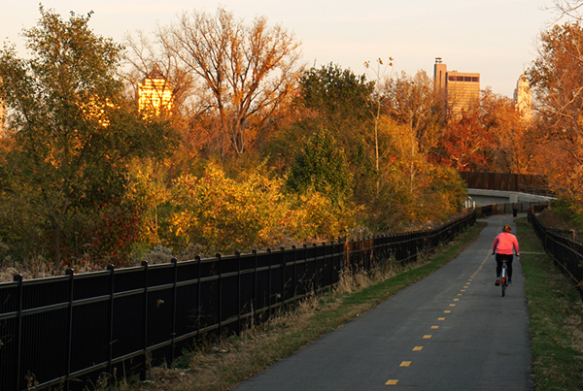
2021 Talking Pts – “Impactful Climate Action”
Investing in active transportation infrastructure is a meaningful response to the climate crisis – facilitating walking, biking and rolling can significantly lower our carbon footprint. Trails are an important aspect of AT infrastructure and serve to mitigate climate change.
For 2020 Trails Highlights/Accomplishments, check out www.railstotrails.org/trailblog/2020/december/23/looking-back-with-gratitude-on-a-year-of-challenges-and-triumphs-for-trails/
Notes:
Key players within the Rails-to-Trails and Buckeye Trail Association are assembling and convening sessions with representatives of agencies, non-profit advocacy groups and even business groups from across the state who are already involved in driving trail, active transportation, recreation and public health initiatives in their respective regions. Currently (early 2018) the Network is meeting every 6-8 weeks to develop in greater detail the elements of a successful statewide program. This OhioNetwork will lead on assessing options and then developing recommendations to the General Assembly in the areas of:
1. High level criteria for the facilities which ultimately constitute the statewide network of trails & bikeways
2. Policies
3. Funding mechanisms
4. Funding amounts

Slide 10
Telling Your Stories
The recently adopted trail vision focuses on new trail miles that will extend existing trails, fill in gaps in trail corridors, connect neighborhoods to job centers, and create a truly interconnected network of trails useful for both transportation and recreation.
Elements
Be specific about your personal experience with trail(s)
Highlight the regional and statewide aspects & opportunities
Show sensitivity to challenges caused by the pandemic
Strategically select talking points that will resonate
Provide visuals to help tell your story
Consider potential asks – join Caucus, support Clean OH, relevant policy initiatives, operating/capital budget requests
Notes:
Key players within the Rails-to-Trails and Buckeye Trail Association are assembling and convening sessions with representatives of agencies, non-profit advocacy groups and even business groups from across the state who are already involved in driving trail, active transportation, recreation and public health initiatives in their respective regions. Currently (early 2018) the Network is meeting every 6-8 weeks to develop in greater detail the elements of a successful statewide program. This OhioNetwork will lead on assessing options and then developing recommendations to the General Assembly in the areas of:
1. High level criteria for the facilities which ultimately constitute the statewide network of trails & bikeways
2. Policies
3. Funding mechanisms
4. Funding amounts

Slide 11
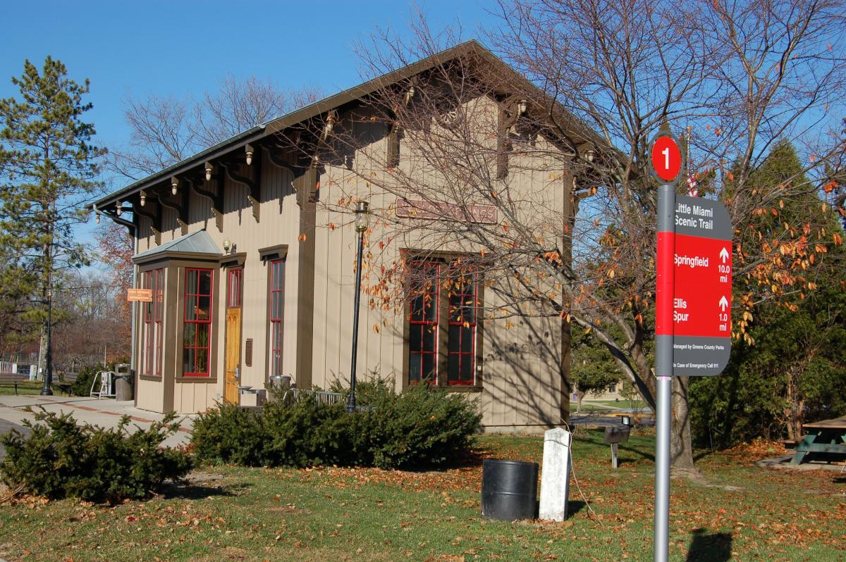
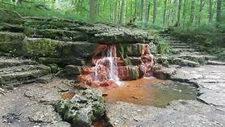
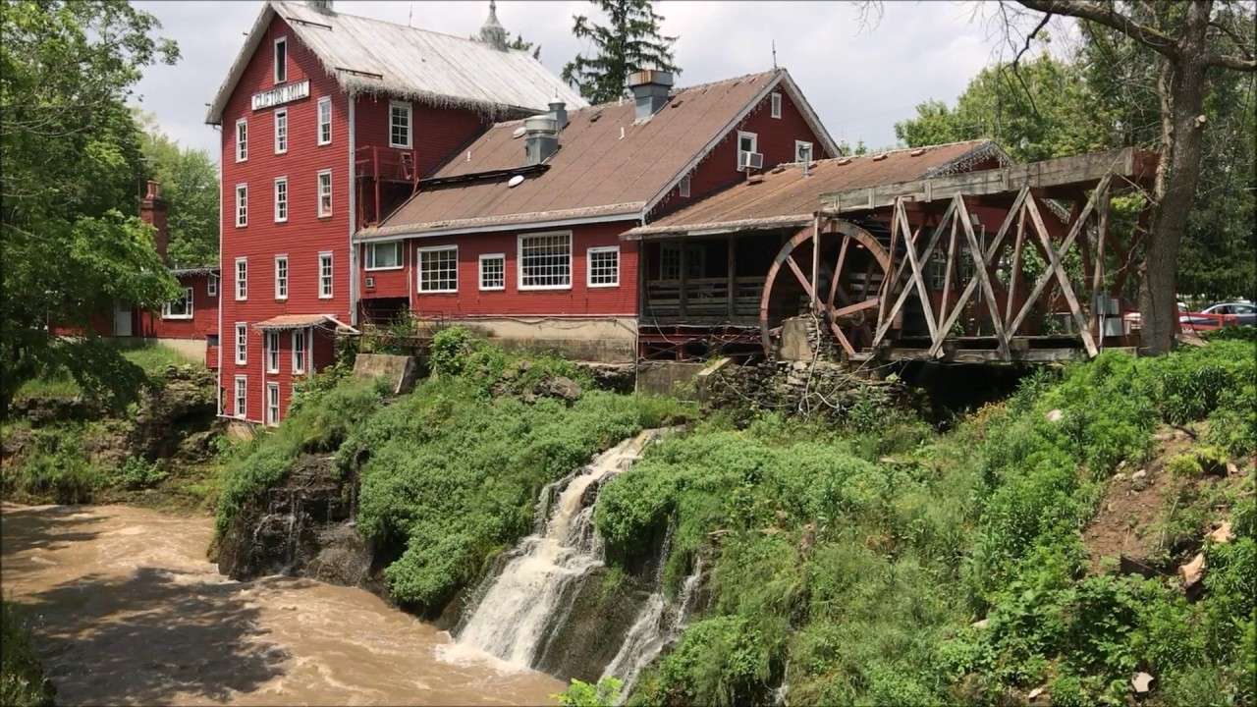
Let’s Build A Trail!
Step 1 – Develop A Vision – helps engage key players, include elected officials, agencies, business owners, etc.
Step 2 – Expand “Friends” Group – be strategic about engaging stakeholders who can contribute & advocate
Step 3 – Brainstorm Potential Alignments – put all ideas on the table & expect many challenges and refinements
Step 4 – Engage Pre-Design Support – set yourself up for success with solid measurements and cost estimates
Step 5 – Finalize Alignment & Make Plan – consider phasing project to facilitate activities and show progress
Step 6 – Seek Funding & Start Construction – pursue government, private, foundation; collaborate = efficiencies
www.railstotrails.org/build-trails/trail-building-toolbox
Notes:
Key players within the Rails-to-Trails and Buckeye Trail Association are assembling and convening sessions with representatives of agencies, non-profit advocacy groups and even business groups from across the state who are already involved in driving trail, active transportation, recreation and public health initiatives in their respective regions. Currently (early 2018) the Network is meeting every 6-8 weeks to develop in greater detail the elements of a successful statewide program. This OhioNetwork will lead on assessing options and then developing recommendations to the General Assembly in the areas of:
1. High level criteria for the facilities which ultimately constitute the statewide network of trails & bikeways
2. Policies
3. Funding mechanisms
4. Funding amounts

Slide 12
Legislative Trails Caucus Concept
A bipartisan/bicameral group of state legislators committed to creating a statewide trails network that provides significant health, economic and other quality of life benefits for all residents.
Notes:
Background:
1. In April, 2017, at the encouragement of the Buckeye Trails Association, a stakeholder group comprised of various user groups (i.e. mountain bikers, Horseman’s Association, hikers, etc.) and the Midwest Rails-to-Trails Conservancy, a group of both Senators and House Representatives united to establish a Legislative Trails Caucus. As of January, 2018, there are 29 members: 8 Senators; 21 Representatives; 18 Democrats; 11 Republicans. The Co-Chairs are Sen. Sean O’Brien (D, Ashtabula, Geauga, Trumbull cos.) and Sen. Steve Wilson (R, Butler & Hamilton cos.)
2. The Caucus set a goal of having an awareness raising event which they held in Oct., 2017. More than 134 participants, the legislators, their staff and engaged citizens from many partner stakeholder groups participated in rides, walks and even kayaking in downtown Columbus on the Scioto River trails.
3. Also in Oct., Midwest Rails-to-Trails convened a new stakeholder group of public, private and non-profit organizations representing the various geographic regions across the entire state.
4. In Dec. 2017, the General Assembly authored a Joint Resolution declaring 2018 Ohio’s Year of the Trails. The Senate passed this resolution in Dec., 2017. The House is positioned to pass it in late Feb. or early March, 2018.

Slide 13
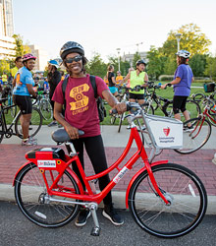
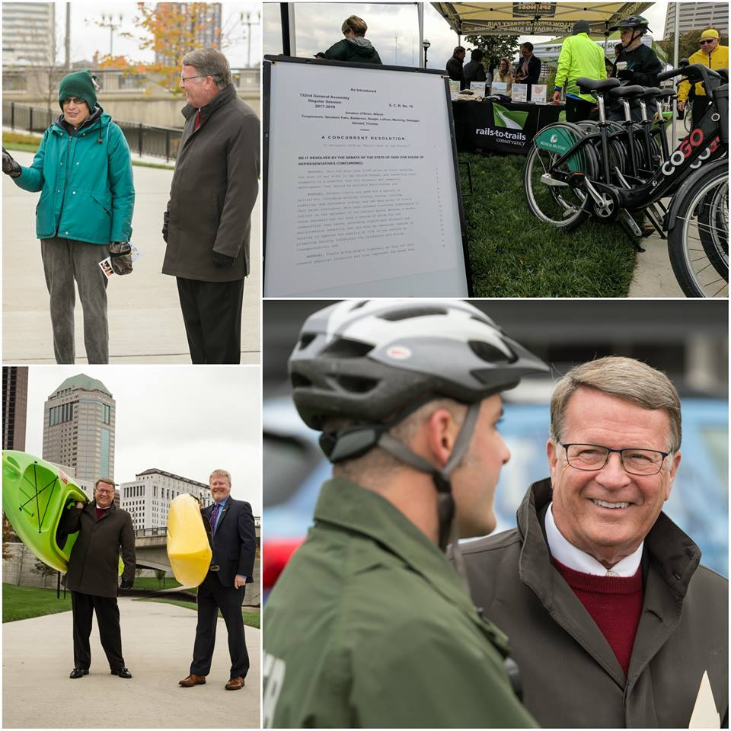
Ohio Trails Caucus in Action
Mar 29, 2017 - Caucus Forms; Now 49 Members (Over 37% of Legislature; Convenes May & Sep)
Oct 25, 2017 Kickoff Event with 200+ Legislators & Staff & Partners on Scioto Trail near Statehouse
Nov 29, 2017 - Senate Unanimously Passes SCR 15 Designating 2018 “Ohio’s Year of the Trails”
Jan 2018 - Dept of Natural Resources Launches Online Trail Map (trails.ohiodnr.gov)
Mar 2018 & 2019 - Advocacy Day & Caucus
Anniversary Celebration (trails.ohiodnr.gov)
May 2019 – New State Trails Plan – The Ohio Trails Vision - is Released
Notes:
Background:
1. In April, 2017, at the encouragement of the Buckeye Trails Association, a stakeholder group comprised of various user groups (i.e. mountain bikers, Horseman’s Association, hikers, etc.) and the Midwest Rails-to-Trails Conservancy, a group of both Senators and House Representatives united to establish a Legislative Trails Caucus. As of January, 2018, there are 29 members: 8 Senators; 21 Representatives; 18 Democrats; 11 Republicans. The Co-Chairs are Sen. Sean O’Brien (D, Ashtabula, Geauga, Trumbull cos.) and Sen. Steve Wilson (R, Butler & Hamilton cos.)
2. The Caucus set a goal of having an awareness raising event which they held in Oct., 2017. More than 134 participants, the legislators, their staff and engaged citizens from many partner stakeholder groups participated in rides, walks and even kayaking in downtown Columbus on the Scioto River trails.
3. Also in Oct., Midwest Rails-to-Trails convened a new stakeholder group of public, private and non-profit organizations representing the various geographic regions across the entire state.
4. In Dec. 2017, the General Assembly authored a Joint Resolution declaring 2018 Ohio’s Year of the Trails. The Senate passed this resolution in Dec., 2017. The House is positioned to pass it in late Feb. or early March, 2018.

Slide 14
The OhioNetwork
“A multi-regional coalition advocating to complete & execute trail/active transportation plans across the Buckeye State, creating
a statewide trails network to connect Ohioans.”
Ultimate Goals:
Statewide Recreational/Active Transportation Trail Network
Innovative Policies to Support Trail Network Development
Increased Dedicated Funding for Construction & Maintenance
Funding Assistance to Complete Local/Regional Trail/AT Plans
Connecting People, Places & Opportunities
Notes:
Key players within the Rails-to-Trails and Buckeye Trail Association are assembling and convening sessions with representatives of agencies, non-profit advocacy groups and even business groups from across the state who are already involved in driving trail, active transportation, recreation and public health initiatives in their respective regions. Currently (early 2018) the Network is meeting every 6-8 weeks to develop in greater detail the elements of a successful statewide program. This OhioNetwork will lead on assessing options and then developing recommendations to the General Assembly in the areas of:
1. High level criteria for the facilities which ultimately constitute the statewide network of trails & bikeways
2. Policies
3. Funding mechanisms
4. Funding amounts

Slide 15
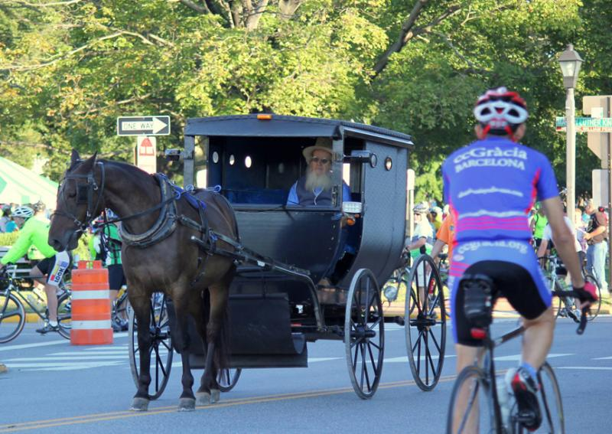
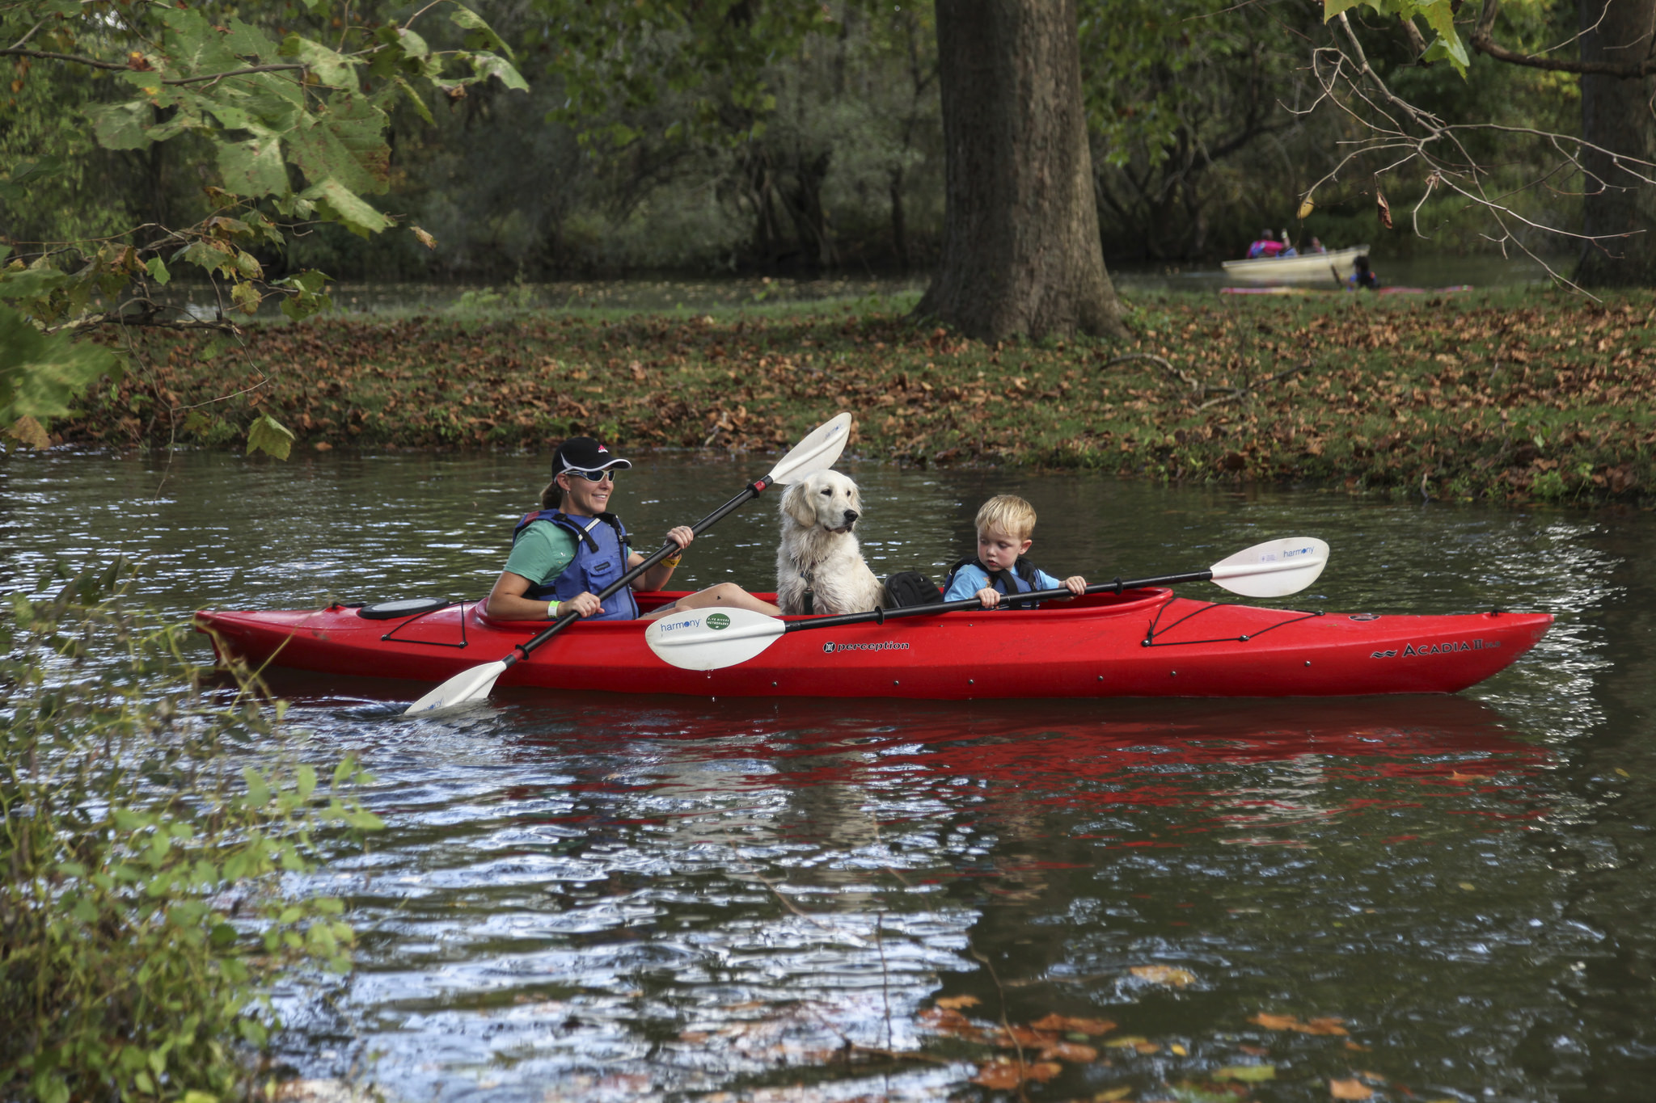
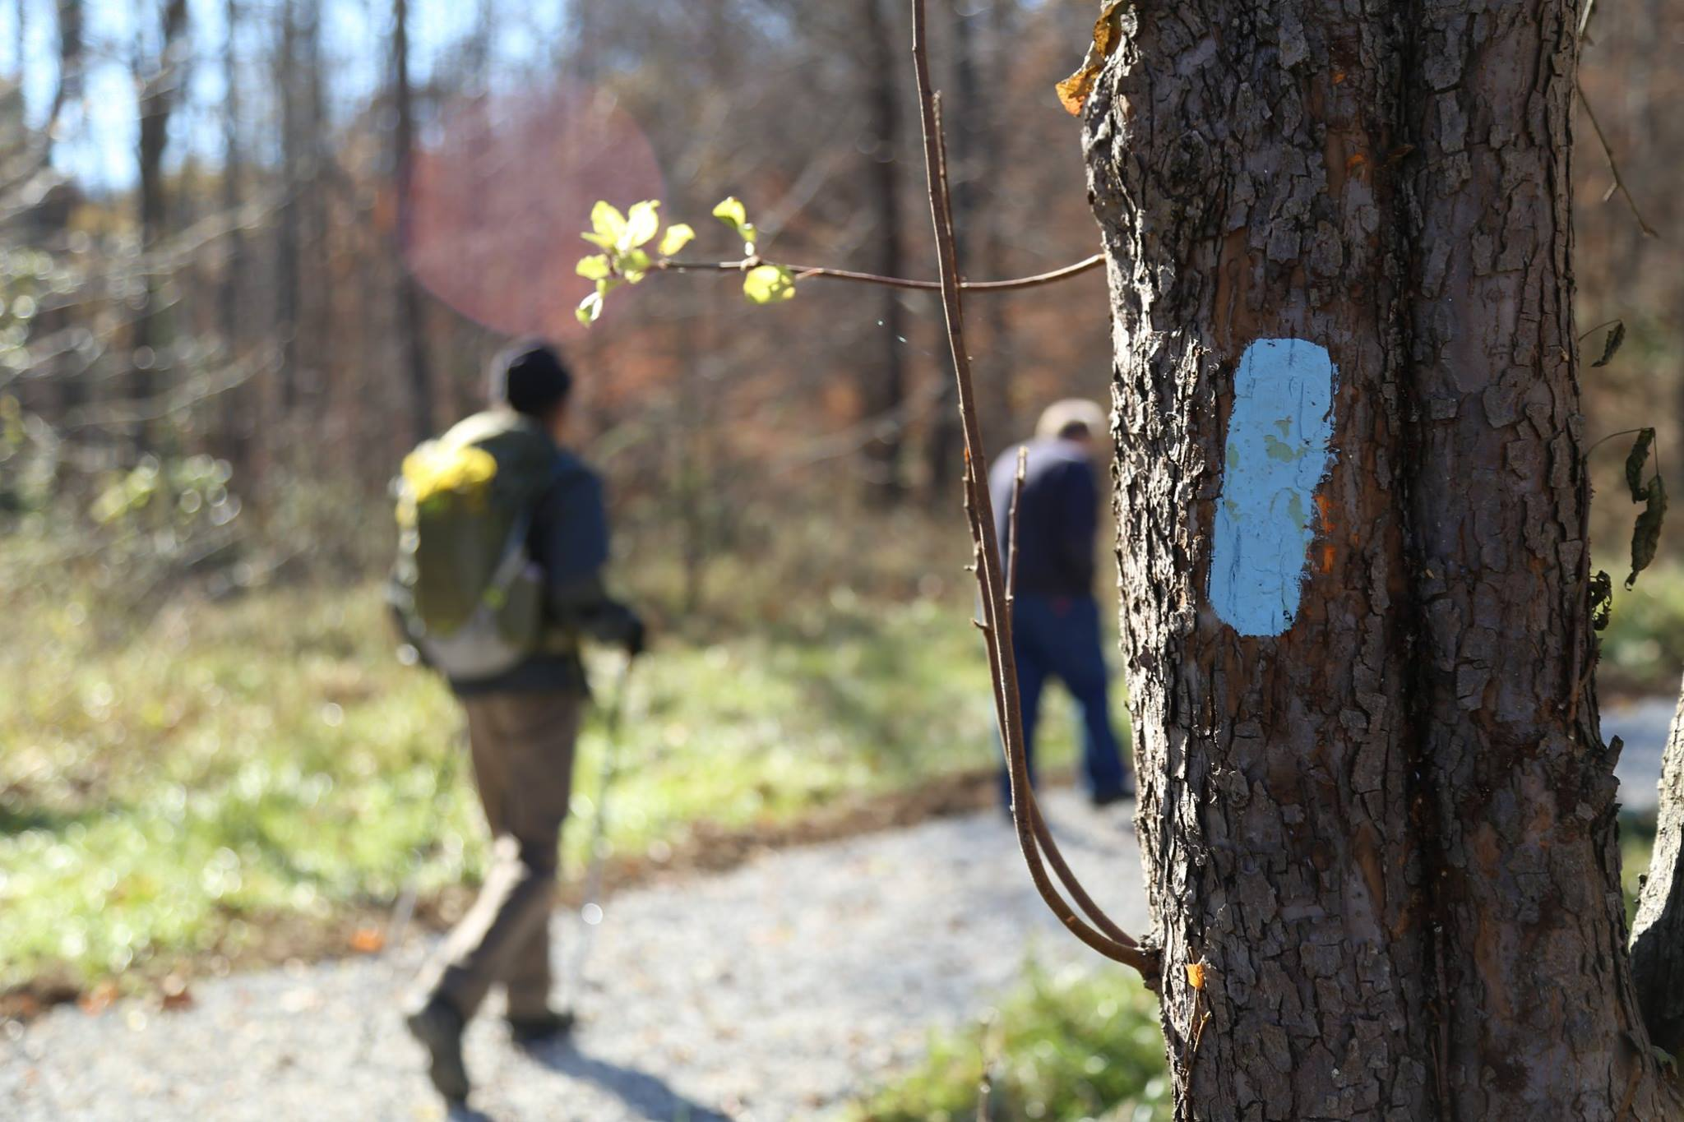
Diverse Collection of Stakeholders
A critical success factor is getting buy in from a broad range of organizations in all regions to increase the impact of this collective advocacy initiative –
Municipalities/Trail Managers
MPOs/State Agencies
Chambers/CVBs
Health Organizations
Land Trusts/Conservancies
Nonprofits
Private Sector
Trail Advocates/Users (All Types)
Public Transit
Notes:
The list of participants is too long to put on a slide. This is a good representation.

Slide 16
Opportunities – We Need YOU!
What are the priorities and How do we move forward?
Connectivity & Maintenance
Inter-Agency Working Group / State Trails Task Force
Statewide Economic Impact Study
Agency Capacity to Support Trails/AT
Build Caucus Membership
Tell your state legislators to be a voice for Ohio Trails by joining the Ohio Legislative Trails Caucus, a bipartisan group of state elected officials committed to creating a statewide trails network to connect Ohioans!
Find your state senator and representative via www.legislature.ohio.gov.
View current Caucus membership at www.railstotrails.org/policy/building-active-transportation-systems/active-transportation-policy-hub/pages/ohio-legislative-trails-caucus.
Send a message via www.railstotrails.org/ohcaucus.
Notes:
Key players within the Rails-to-Trails and Buckeye Trail Association are assembling and convening sessions with representatives of agencies, non-profit advocacy groups and even business groups from across the state who are already involved in driving trail, active transportation, recreation and public health initiatives in their respective regions. Currently (early 2018) the Network is meeting every 6-8 weeks to develop in greater detail the elements of a successful statewide program. This OhioNetwork will lead on assessing options and then developing recommendations to the General Assembly in the areas of:
1. High level criteria for the facilities which ultimately constitute the statewide network of trails & bikeways
2. Policies
3. Funding mechanisms
4. Funding amounts

Slide 17
Questions?
Brian Housh
Midwest Policy Manager
brianh@railstotrails.org
Connect with RTC:
www.railstotrails.org
@railstotrails

